Slide 1








SMART IRRIGATION & CROP ADVISORY SYSTEM (AI + IOT)
By Team: AgriSense
DIVYANSHU SINGH
EC23B1129
IIITD&M KANCHEEPURAM

Slide 2
PROBLEM STATEMENT
Indian farmers often face issues of over-irrigation or under-irrigation due to lack of real-time soil moisture and weather data.
Most technical agricultural data is in English or complex terms, making it inaccessible to many rural farmers.
Farmers lack personalized advice on which crops suit their soil nutrients and climate.
This causes water wastage, higher electricity costs, and reduced crop yields.

Slide 3
INDIAN AGRICULTURE TRENDS SINCE INDEPENDENCE
Food grain production increased from ~135 million tons (1950-51) to ~1300 million tons (2021-22).
The Green Revolution brought yield improvements, but water and input use efficiency remain low.
India uses ~70-80% of freshwater for agriculture, with significant wastage.
Crop productivity and water efficiency vary greatly by region.

Slide 4
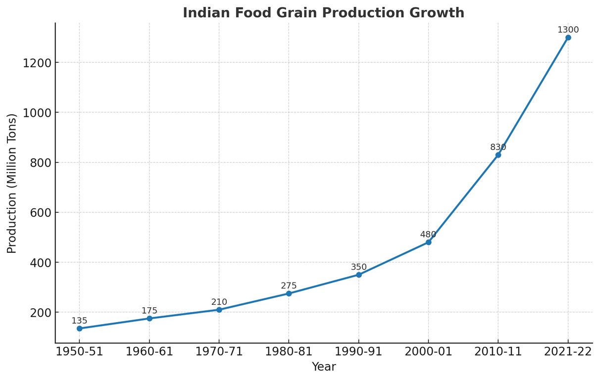
INDIAN AGRICULTURE TRENDS SINCE INDEPENDENCE

Slide 5
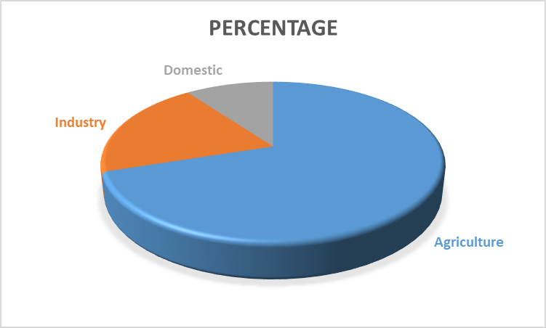
WATER USAGE DISTRIBUTION IN INDIA BY SECTOR

Slide 6
SOLUTION OVERVIEW
AI- and IoT-powered system combining:
Soil moisture sensors for real-time irrigation data
Nutrient sensors (NPK) for soil quality assessment
Weather APIs for local forecast integration
AI analyzes data & generates simple, personalized irrigation and crop advice.
Advice delivered in farmers’ local languages through WhatsApp, SMS, or voice calls

Slide 7
FEATURES & EXAMPLES
Example messages:
“Soil moisture low; irrigate wheat field for 2 hours tomorrow morning.”
“Rain expected tonight; delay watering to save water.”
“Soil nitrogen-rich; maize & pulses suitable for this season.”
System supports multiple crops & languages.
Offers voice messages for farmers with low literacy.

Slide 8
HOW OPENAI APIS ARE USED
Convert technical sensor & weather data into easy-to-understand advice.
Translate advisory messages into Hindi, Telugu, Tamil, etc.
Generate audio messages for voice-based delivery.

Slide 9
FEASIBILITY & EXECUTION PLAN
Phase 1: Prototype using Arduino/Raspberry Pi + sensors + weather data integration + WhatsApp delivery.
Phase 2: Pilot testing with local farmer groups; collect feedback.
Phase 3: Scale through partnerships with agri-tech startups, government agriculture departments, widen crop/language support.

Slide 10
IMPACT & BENEFITS
Water savings of 25-50% by avoiding over-irrigation.
Crop yield improvement of 15-20% through targeted irrigation & crop advice.
Electricity bill reduction by cutting unnecessary pump use.
Improved farmer incomes, sustainable water management.
Supports rural farmers with accessible technology in their language.

Slide 11
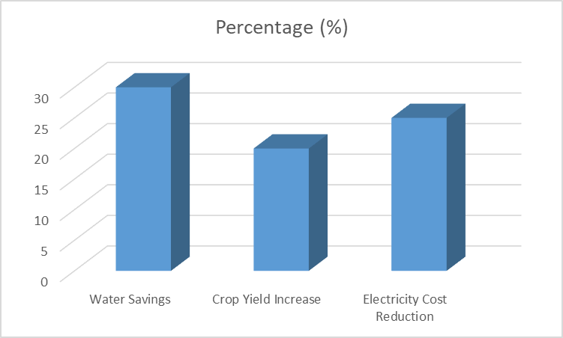
PREDICTED IMPACT OF SMART IRRIGATION SYSTEM

Slide 12
PREDICTION & LONG-TERM VISION
By adopting this system nationwide:
Significant conservation of water resources in agriculture, India's largest water user.
Boost in national food grain production efficiency.
Empowered farmers making informed crop and irrigation decisions, improving livelihoods.
Support government initiatives on sustainable agriculture and water use.

Slide 13
THANK YOU
EMPOWERING FARMERS WITH SMART, LOCALIZED ADVICE

